Slide 1



SOFTWARE DEVELOPMENT PROFESSIONAL PROGRAM
Choosing Your Tools

Slide 2





Choosing Your Tools
Learning Objectives
Define system requirements for success in the course.
Open up your terminal and other programs.
Perform keyboard shortcuts for common tasks.
Install needed tools on a development computer.

Slide 3

Choosing Your Tools
System Requirements
Requirements
Recommendations
Personal computer no more than 5-6 years old
Second screen of some sort
MacOS, Linux, or Windows operating system
Macbook that can run the latest MacOS
Second screen is 23" or larger and not a TV
MacOS or Linux**
Notes:
**Note: Use Linux only if you are already familiar with it. Don't pick it up for this course.
These requirements are a good minimum for success in the course.
- Personal Computer: Not shared with other people
- Second screen: Will make development more efficient; ease of remote learning
The recommendations are optional extras for those who have the resources and want them.
Best monitor reviews: https://www.rtings.com/monitor/reviews/best/by-usage/programming-and-coding

Slide 4
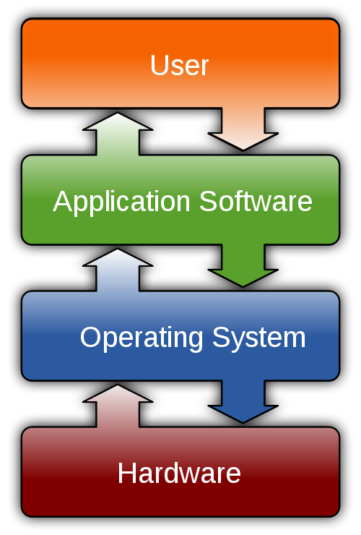
Choosing Your Tools
What Is an Operating System?
An OS is software that handles your computer's memory and processes.
It manages your computer's hardware and software.
Source: Wikimedia Commons
Notes:
Windows, MacOS, and Linux are the main operating systems in use today.

Slide 5

Choosing Your Tools
Account Requirements
Requirements
A Canvas account
A free account on GitHub
A free account on Replit
Octocat/GitHub logos are provided by GitHub and used legally as a promotion of GitHub.
Notes:
- Your Canvas account is used to access all of the course material
- GitHub is where you can store and share your code. Make sure your GitHub username is professional;
potential employers will look at your github account.
- Replit is an easy way to test out code without having to spin up a whole new project.

Slide 6


Choosing Your Tools
Installation Requirements
Tools we need to install*:
Node.js
Git
VSCode (or your choice)**
Chrome (or your choice)**
*Installations will naturally vary by operating system.
**VSCode and Chrome work across all OSs.
Source: Code.VisualStudio.com
Notes:
We recommend that you use VSCode as your text editor and Chrome as your internet browser. There are
certainly valid alternatives to these (e.g., Atom, Sublime Text as editor, or Firefox Developer as browser).
If you are already a user of these alternatives, please feel free to continue doing so. If in doubt, ask us!
In our activity, we will go into more depth on the things that are specific to each operating system.
This will include things like Git Bash for Windows or the Homebrew Installer for Mac.

Slide 7

Choosing Your Tools
Keyboard Shortcuts
Small improvements add up over time!
Most programs have keyboard shortcuts.
Your browser (e.g., Chrome)
Your text editor (e.g., VSCode)
Your terminal
Source: PXHere
Notes:
We will be using computers a lot, so small improvements that save a bit of time add up to big time savings.
The most important places to memorize a few shortcuts are your browser, your text editor, and your terminal.

Slide 8
Choosing Your Tools
Keyboard Shortcuts: Chrome Browser
Action | PC | Mac
New Tab | Ctrl + T | Command + T
Restore Closed Tab | Ctrl + Shift + T | Command + Shift + T
Refresh Page | Ctrl + R | Command + R
Open Developer Tools | Ctrl + Alt + J | Command + Option + J
Find Text | Ctrl + F | Command + F
Copy/Paste Selected Text | Ctrl + C / Ctrl + V | Command + C / Command + V
Notes:
Do you have your browser open? Don't be shy, try them out!
A hard refresh forces the page to reload all its resources. This can be important if, say, you're a
developer in the middle of creating those resources!
<< Hard reload is not listed on the table; if there is time, demonstrate how to do a hard reload. >>

Slide 9

Choosing Your Tools
Keyboard Shortcuts: VSCode
Action | PC | Mac
Find Text | Ctrl + F | Command + F
Save File* | Ctrl + S | Command + S
Select Multiple | Ctrl + D | Command + D
Move Lines | Alt + Up/Down (Arrows) | Option + Up/Down (Arrows)
Notes:
*Pro Tip: Turn on autosave in VSCode by navigating to File in the menu bar and checking Autosave.
<< This is a great time to demo the Command + D feature of selecting the same text in
multiple locations and changing many things at once. >>

Slide 10
Choosing Your Tools
Terminal
A computer program
That allows us to type instructions and is used by programmers for many development tasks

Slide 11

Choosing Your Tools
Keyboard Shortcuts: Terminal
Sure, the terminal can get you into some trouble, but don't worry-we have the ultimate escape hatch:
Ctrl + C
That's it! This little command will stop any process that is running on your terminal.
Source: Pixabay
Notes:
Don't let the terminal scare you; it's not as bad as it sounds. We can quit any time we want!
We'll be learning more about using the terminal in the next lesson.

Slide 12

Choosing Your Tools
Quiz: Let's Discuss
What's a good reason for memorizing a few keyboard shortcuts?
A. Increasing your confidence
B. Saving a little bit of time
C. Cut down on mouse usage
D. Multi-task more efficiently
E. All of the above

Slide 13
Choosing Your Tools
Quiz: Multiple Choice Answers
What's a good reason for memorizing a few keyboard shortcuts?
🚫 A. Increasing your confidence
🚫 B. Saving a little bit of time
🚫 C. Cut down on mouse usage
🚫 D. Multi-task more efficiently
✅ E. All of the above
BONUS: Some VSCode shortcuts allow you to do things not possible in other programs.
Notes:
In particular, some keyboard shortcuts in VSCode allow you to do things like mass updates
that couldn't be done other than with a keyboard shortcut.

Slide 14

Choosing Your Tools
Summary
What We've Covered
Tools & Tips
Technical Requirements
Operating System (OS)
Keyboard Shortcuts
You're ready to hit the ground running!
Notes:
With what we covered today, you should be ready to hit the ground running on the next day of class!

